Slide 1
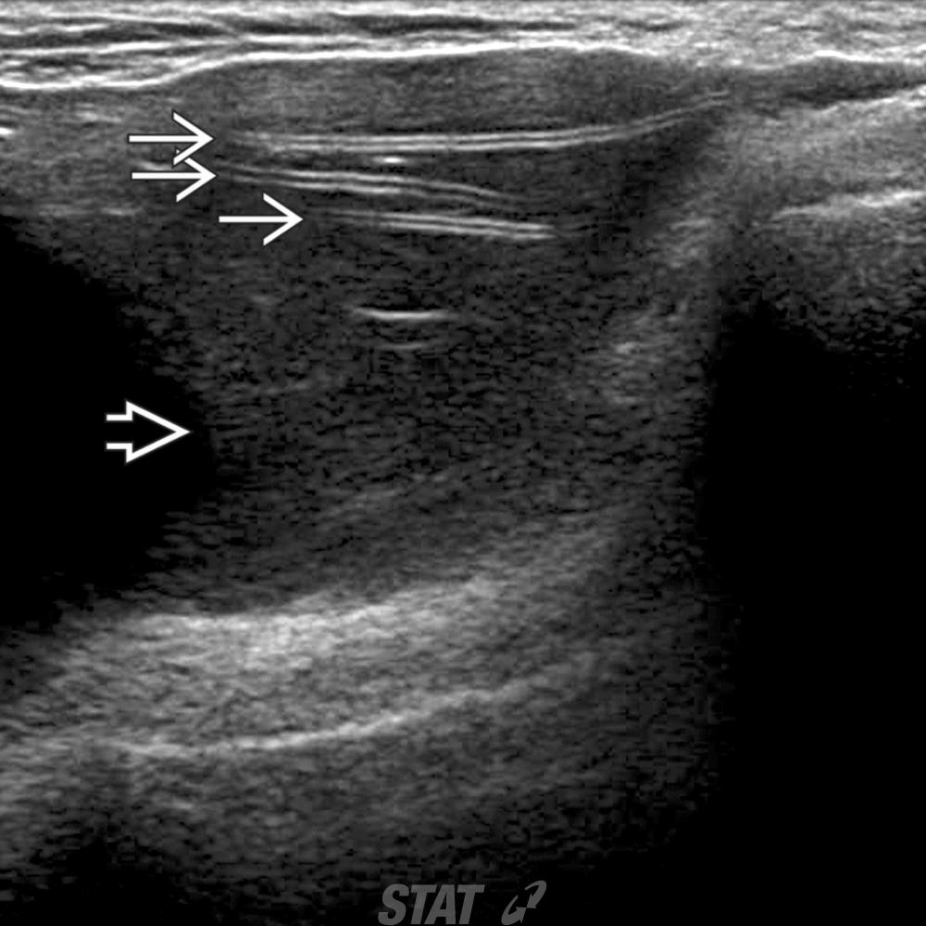
This 64-year-old woman had bilateral mastectomies for FCC and implant reconstruction 20 years ago. US of the left breast implant shows the stepladder sign representing collapsed layers of implant shell (white solid arrow) (analogous to linguine sign on MR) in this example of intracapsular rupture. Low-level echoes (white open arrow) are also noted.

